Slide 1


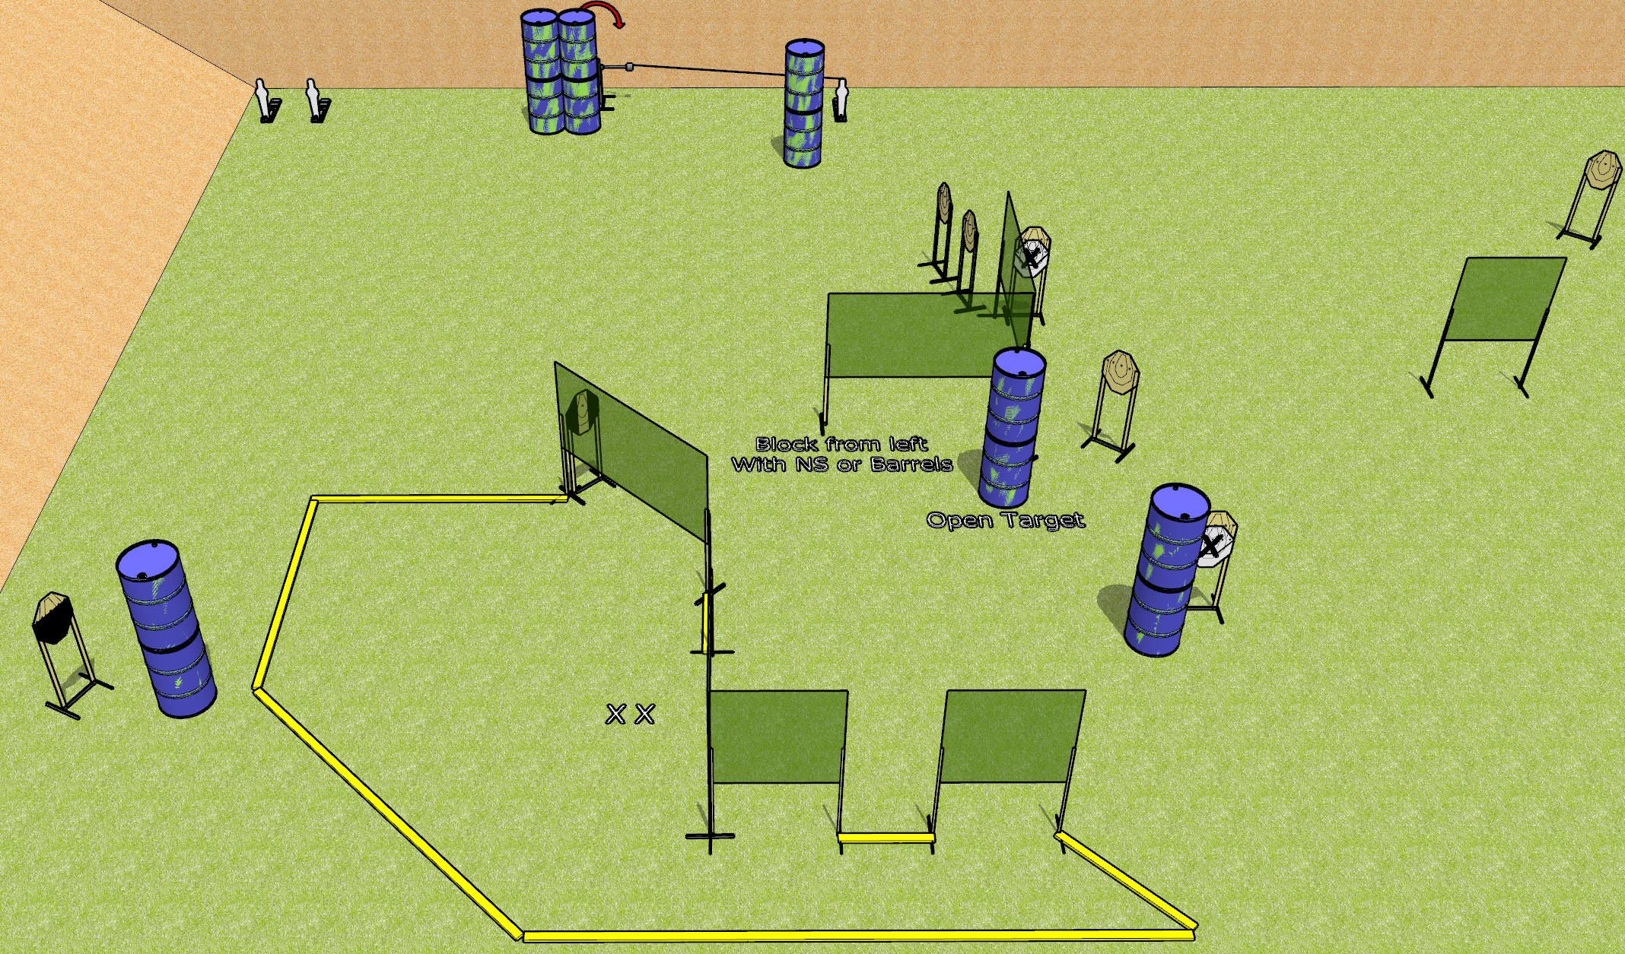
 | Dothan Gun Club – USPSA Match To the Extreme Course Designer : Drew Coleman
Round Count 23 rounds 10 IPSC 3 mini poppers
Equipment List 12 wall feet 1 medium fault line, 2 3’ fault lines 1 swinger + activator 1 tuxedo, 1 50% Aligning the activator steel: line it up with the left foot of the right narrow wall, at 50 feet

Slide 2
To the Extreme
Written Stage Briefing
To the Extreme is a 23 round, 115 point, Comstock course of fire. There are 10 IPSC targets and 3 mini poppers. The best 2 hits on paper will score, and steel must fall to score. The start signal is audible.
The swinger is activated by the rightmost mini popper. Please check the activator prior to walkthrough and set it the same way every time.
Handgun start position is both feet on X’s, wrists below belt. Handgun is loaded and holstered.
PCC start position is both feet on X’s, stock on belt. Loaded carbine is loaded with safety on.
On start signal, engage targets as they become available from within the shooting area.

Slide 3
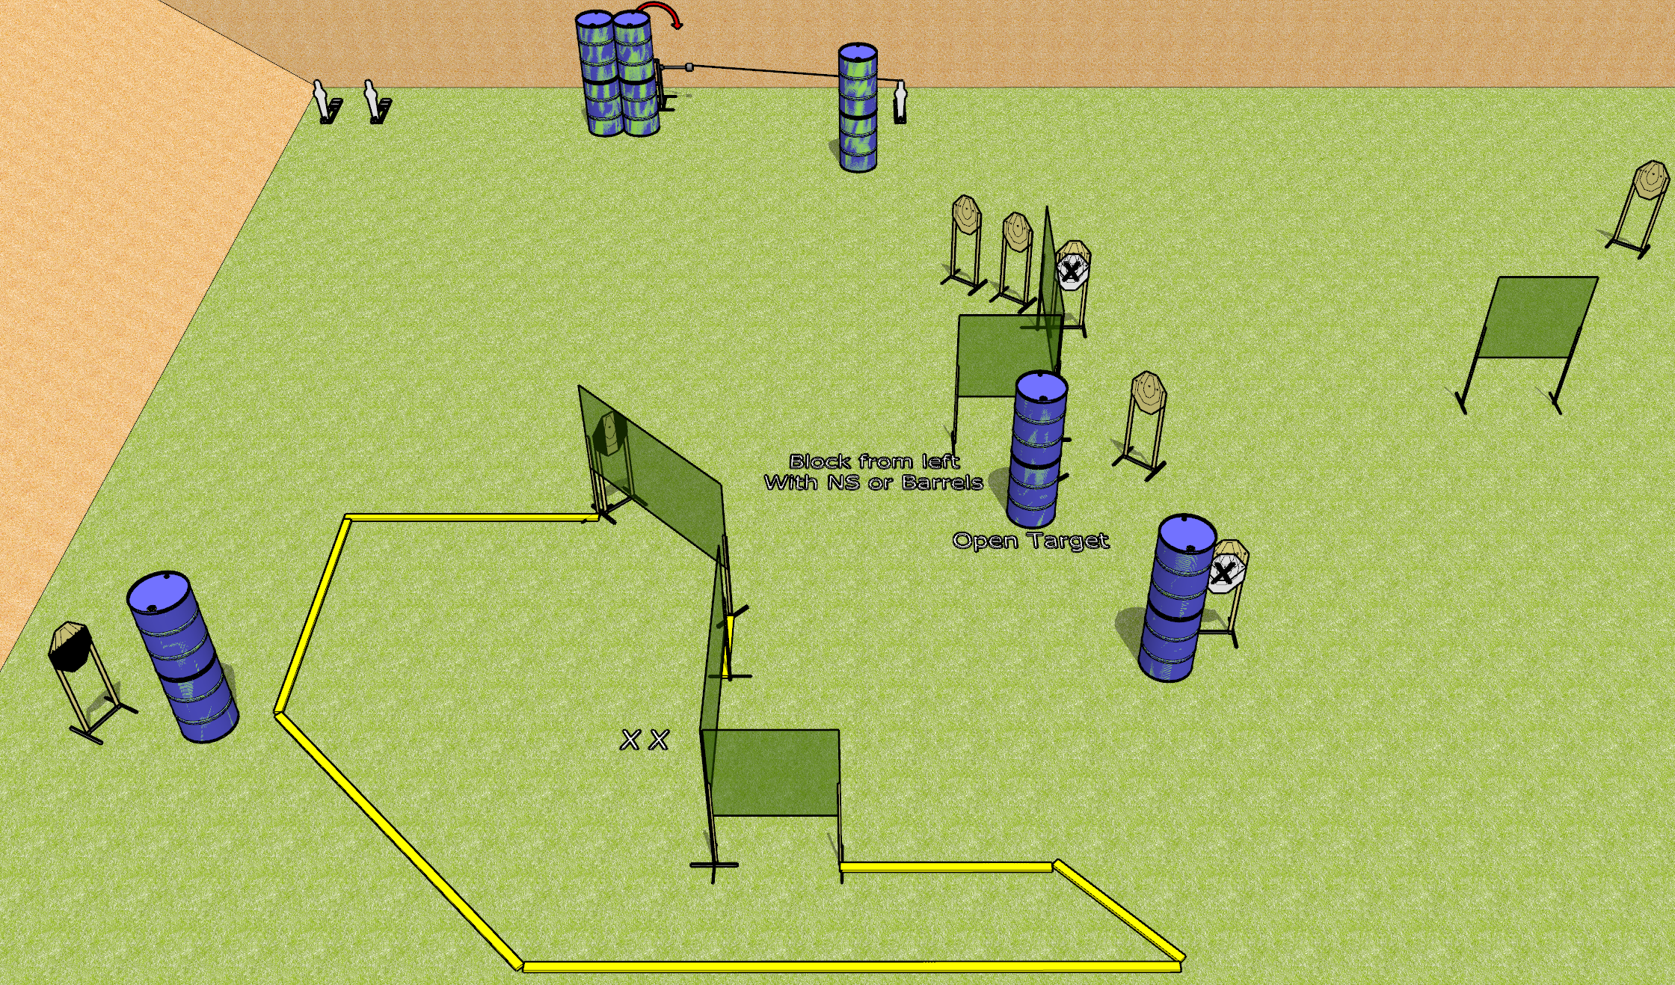
 | Dothan Gun Club – USPSA Match To the Extreme Course Designer : Drew Coleman
Round Count 23 rounds 10 IPSC 3 mini poppers
Equipment List 12 wall feet 1 medium fault line, 2 3’ fault lines 1 swinger + activator 1 tuxedo, 1 50% Aligning the activator steel: line it up with the middle of the fault line to the right of the narrow wall at the bottom of the shooting area, at 50 feet

Slide 4
To the Extreme
Written Stage Briefing
To the Extreme is a 23 round, 115 point, Comstock course of fire. There are 10 IPSC targets and 3 mini poppers. The best 2 hits on paper will score, and steel must fall to score. The start signal is audible.
The swinger is activated by the rightmost mini popper. Please check the activator prior to walkthrough and set it the same way every time.
Handgun start position is both feet on X’s, wrists below belt. Handgun is loaded and holstered.
PCC start position is both feet on X’s, stock on belt. Loaded carbine is loaded with safety on.
On start signal, engage targets as they become available from within the shooting area.

